Slide 1

5/14/25
Promoting
Your Research
Tim Doty

Slide 2
Tim Doty timdoty@tamu.edu
Assistant Vice President for National Media and Public Relations.
Previously: Purdue University – crisis and issues comms, strategic comms and led media relations team.
23 years in local TV news – sports, lifestyles and hard news.

Slide 3
Who is the news team?
Darren Benson – editor and “air traffic controller” Darren.benson@tamu.edu.
Lesley Henton – writer lshenton@tamu.edu.
*Caitlin Clark – writer caitlinclark@tamu.edu.
*Emma Lawson – writer miss.emma.lawson@tamu.edu.
Zaid Eleyyan – writer zeleyyan@tamu.edu.

Slide 4
Central MarComm goals
Build reputation – grow national awareness and esteem for Texas A&M as a Force For Good.
Drive relevance – create deep association with the topics and conversations that matter the most.
Earn trust – lead the national conversation as a trusted voice with thought leaders.

Slide 5
Strategy matters
Research stories that are not sent to media most likely will not be seen by media.
A faculty member could be best in their field but if media do not know of them or how to contact them, they’ll move down the list to find somebody else.
We cannot spam journalists, so we must act strategically, picking and choosing what goes, where and when.

Slide 6
Who is the news team?
Darren Benson – editor and “air traffic controller” Darren.benson@tamu.edu.
Lesley Henton – writer lshenton@tamu.edu.
*Caitlin Clark – writer caitlinclark@tamu.edu.
*Emma Lawson – writer miss.emma.lawson@tamu.edu.
Zaid Eleyyan – writer zeleyyan@tamu.edu.

Slide 7
Why is this important?
If we do not share the story, it may not be seen.
Purdue University 2024 media mentions: approximately 119,000.
Texas A&M ‘24 media mentions: approximately 45,000.
Texas A&M ‘25 media mentions: approximately 76,000.
YoY increase of 72%

Slide 8
What’s in it for you?
Interest in your work from media, academies, national agencies, funders or collaborators.
Tenure help with Altmetrics?
Media training and media relations assistance.
Story site or social media promotion – LinkedIn, X, YouTube.

Slide 9
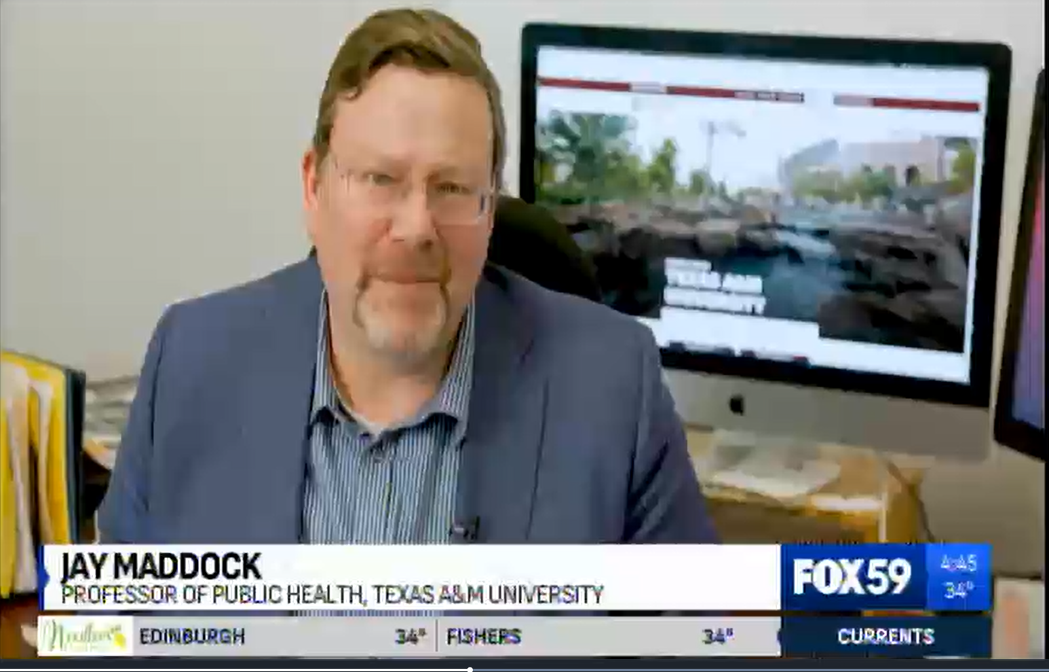
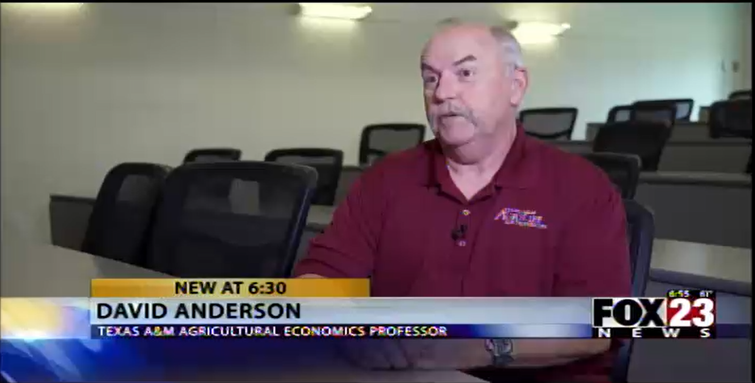
Success stories
Jay Maddock (Public Health):
25 placements in FY ‘24
723 placements in FY ’25
2,792% increase
David Anderson (AgriLife):
233 placements in FY ‘24
3,508 placements in FY ‘25
1,405% increase
Are
You Next?

Slide 10
News release/story
Our writer interviews you and writes the story, follows up and continues coverage of your work.
Stories are complete but are intended to drive media coverage and work written by journalists.
We want several outlets to cover the same topic and we want to cover this research/topic/person over time – no “one and done”.
You will get review and approval rights for the content we create.
We will pitch to media, send to media and share on social media.
Writer will then work with communicator to handle media.

Slide 11
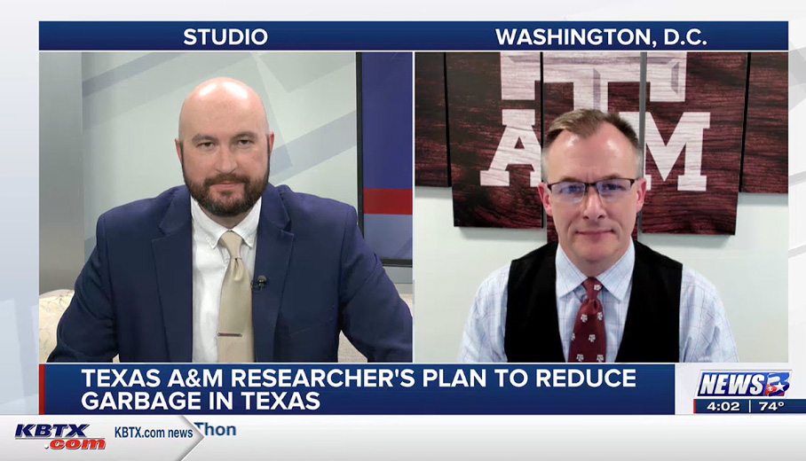
One story, multiple outlets
ARTSCI: Life on Mars? (280 plcements/uses)
VETMED: Kissing bugs and Chagas Disease (500+)
VETMED: 99% of dogs have behavior problems (80+)
ENGINEERING: Self-healing polymer (65+)
Edu/HD: Creatine is safe (60+)
PUBLIC HEALTH: Nature is the medicine (25)
AGRILIFE: Screwworm dangers (100+)
ENGINEERING: Ice battery system (440)

Slide 12
Purdue
Ohio State
Penn State
Ole Miss
UT Austin
Clemson
U Hawaii
CU Boulder
ASU
AP Campus Insights
Texas A&M joins universities, including: Hawai’i, Purdue, Colorado Boulder, Ohio State, Clemson, Mississippi, Penn State, UT Austin, Arizona State.
Videos are 3-7 minutes long and fact-based – not opinions. B-roll is encouraged but not required.
Mix of timely topics and research stories but are not intended to strictly promote the university.
Kitchen table economics and easy science do the best.
Videos are exclusive to AP for 30 days

Slide 13
AP Campus Insights
Approximately 14,000 placements in 14 months.
Nearly 170 videos posted since launch.
Regular usage in the top 10 TV markets, by Fox News, The Weather Channel, Christian Broadcasting Network, Nexstar, Hearst, etc.
Notes:
885 placements
885 placements885 placements

Slide 14
Expert pitch
We let media know that you are an expert on the topic – Ukraine, intelligence, tariffs, Gaza, etc.
We offer a quote and a link to your page, along with contact information.
This only works if you respond when they reach out.
This can build trust and over time, they do not need to be nudged, they will come to you first.
Notes:
885 placements
885 placements885 placements

Slide 15
Questions?

Slide 16
Texas A&M University
Division of Marketing & Communication

