Slide 1
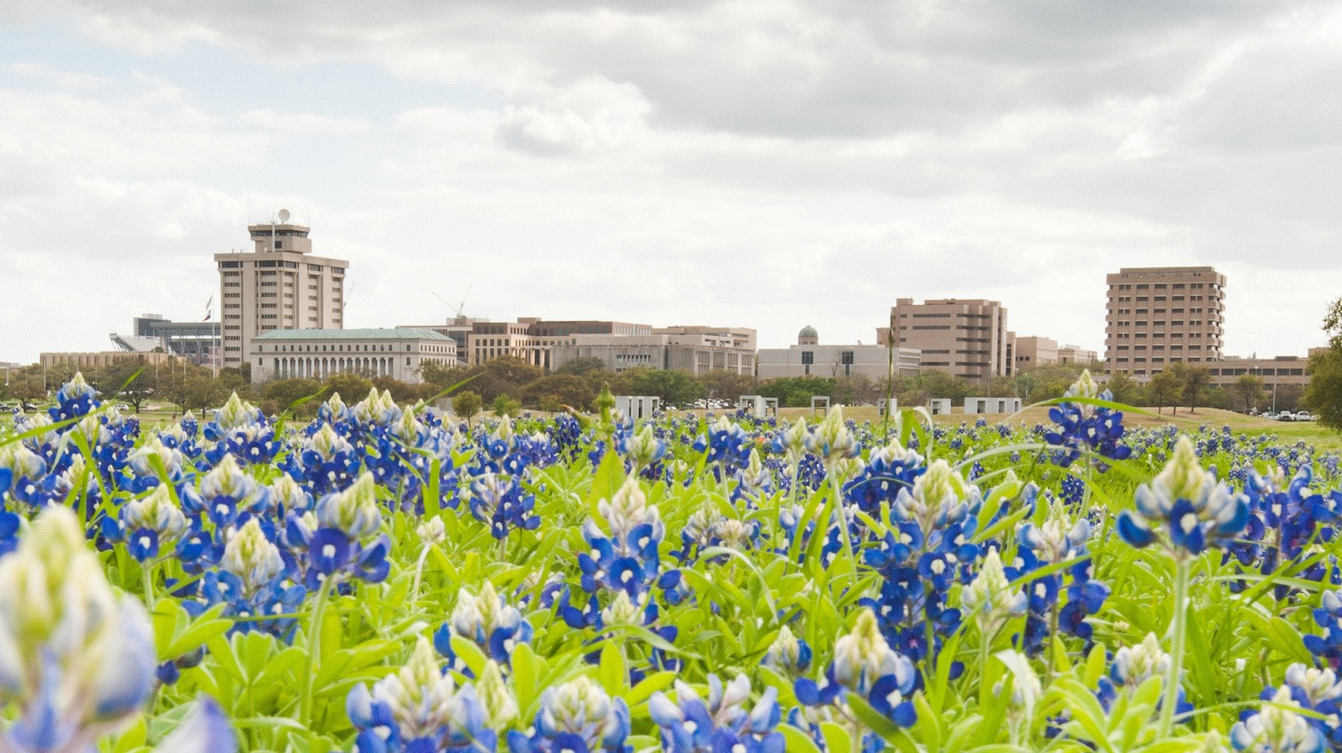
HOWDY!

Slide 2
Nuclear Security Enterprise (NSE)

Slide 4
Nuclear Security Office
Evelyn Mullen
(Associate VC - Nuclear Security Initiatives)
Jim Morel
(Executive Director – National Laboratories Programs)
Janelle Salinas
(Director – Business and Workforce Development)
Brandi Brown (Administrative Manager)
Tania Wolf (Engagement Support Specialist)
Jennifer House
(Program Manager)
Johnny Guelker
(Executive Director – Plants & Sites Programs)
L. Diane Hurtado
(Sr. Associate VC - Nuclear Security Initiatives)
Marvin Adams
Bill Madia
(Sr Advisors)

Slide 5
The A&M System is committed to National Security: The Nuclear Security Office arises from that commitment
VISION: The Texas A&M University System Nuclear Security Office (NSO) serves the nation and state by applying the breadth and depth of A&M System capabilities to enhance national and global nuclear security.
To achieve this vision NSO will:
Contribute substantially as partners in the management and operations (M&O) of Los Alamos National Laboratory and the Pantex Plant.
Leverage investments by the State of Texas and the A&M System to enable missions of the labs, plants, and sites in the NSE.
Apply A&M System expertise and competencies in research, professional development and training to provide innovative solutions to NSE challenges.
Develop the future NSE workforce by connecting NSE entities with the public service minded students that attend A&M System universities.

Slide 6
RESEARCH
Advanced Manufacturing
Nuclear science, engineering
Hypersonics
TRAINING
Leadership
OSHA
High Explosives
Quality

Slide 7
53
$11M RESEARCH AWARDS
$9M TRAINING AWARDS
CURRENT PROJECTS
$20M
AWARDS
EXPERT ENGAGEMENT
2 Universities
(TAMU, TAMUCC)
5 Colleges
(Agriculture, Arts&Sciences, Bush, Engineering, Veterinary Medicine)
4
State Agencies
(AgriLife, TEES, TEEX, TTI)
22
Departments
OVER
300
A&M System Former Students Employed
OVER
70
A&M System Student Interns
14
Joint Appointments

Slide 8
PANTEX Palo Duro Research Facility at West Texas A&M
Collaborative Research Space
RESEARCH
Material Science
Digital Tech
Advanced manufacturing

Slide 9
8
EXPERT ENGAGEMENT
CURRENT PROJECTS
$2.4M
2 Universities
(TAMU, WT)
3 Colleges
(Agriculture, Arts & Sciences, Engineering)
OVER
900
A&M System Former Students Employed at Pantex
(WT, TAMU, TAMIU, ETAMU, Kingsville, Tarleton)
4 State Agencies
(Agrilife, TEES, TEEX, TFS)
Emergency Management
High Explosives Handling
Wildfire Prevention
OVER
20%
of workforce

Slide 10
ACTIVE ENGAGEMENTS
$52M RESEARCH AWARDS
$10M TRAINING AWARDS
$2M STUDENT PROGRAMS
$1M JOINT APMTS
$65M
AWARDS
Lab/Plant/Site | Active Awards | Awarded Amount
Engr | 105 | $ 39,471,998.43
CAS | 20 | $ 4,273,025.63
AG-Res | 9 | $ 14,912,811.00
PVAMU | 4 | $ 248,531.34
TEEX | 3 | $ 3,917,692.78
Bush | 3 | $ 478,745.00
TTI | 2 | $ 384,296.00
VetMed | 1 | $ 322,057.00
TAMUG | 1 | $ 154,730.00
Mays | 1 | $ 918,000.00
Grand Total | 149 | $ 65,081,887.18

Slide 11
TOP TECHNICAL AREAS OF ENGAGEMENTS
ADVANCED MANUFACTURING
MATERIAL SCIENCE/ENGINEERING
NUCLEAR SCIENCE/ENGINEERING
HYPERSONICS
HIGH EXPLOSIVES
BIOMANUFACTURING
EMERGENCY MANAGEMENT
TRANSPORTATION
AGRICULTURAL/FOOD SAFETY
DIGITAL TECHNOLOGY
LEADERSHIP DEVELOPMENT
ENERGY DEVELOPMENT
PHYSICS
CHEMISTRY

Slide 12
Researcher Engagement Facilitation
Researcher are not required to go through NSO to collaborate with any labs or sites.
NSO does not take any indirect and is funded completely out of the fees earned from M&O participation.
NSO can provide:
Connection to researchers and user facilities at NSE labs and sites.
Limited funds to support travel to visit labs and sites.
Limited support of specific applied research in collaboration with labs and sites.
Note: Generally, focus is on US citizen faculty and students due to the national security mission needs.

Slide 13
Questions?
https://nuclearsecurityoffice.tamus.edu/
Evelyn Mullen, P. E.
Associate Vice Chancellor, Nuclear Security Initiatives
Email: emullen@tamus.edu
Phone: 979-862-9149 (office)
Jim E. Morel, Ph.D.
Professor and Nancy & Ron Stinson Professor
TAMUS Co-Director, Joint Center for Resilient National Security
Department of Nuclear Engineering
Email: morel@tamu.edu
Phone: (979) 845-6072

