Slide 1
Texas A&M Sponsored Research Services

Slide 2
Texas A&M Sponsored Research Services
Texas A&M Sponsored Research Services (SRS)
is a consortium of
The Texas A&M University System members
who bring together expertise in
research administration to enhance
the research mission.

Slide 3
Texas A&M Sponsored Research Services
Sponsored Research Services (SRS) was established September 1, 2011,
to enhance research services. SRS provides research administration services
to the Texas A&M University System members with sponsored research
activity based in Brazos County, as well as Texas A&M Galveston and Texas A&M University at Qatar. In addition SRS supports pre-award services for some of the
the systems’ regional campuses.
Est.
2011

Slide 4
Executive Leadership
Kristi Billinger, Executive Director
kristib@tamu.edu
979-845-8673
Associate Executive Directors
Lesley Bell Julie Bishop Crissy Stratta
lbell@tamu.edu jbishop@tamu.edu cstratta@tamu.edu
979.845.7864 979.458.8760 979.458.8452

Slide 5
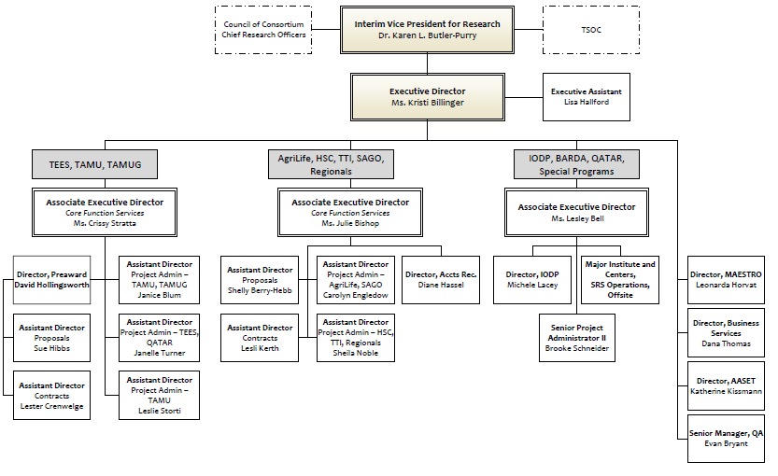
SRS Organizational Structure
August 2017

Slide 6
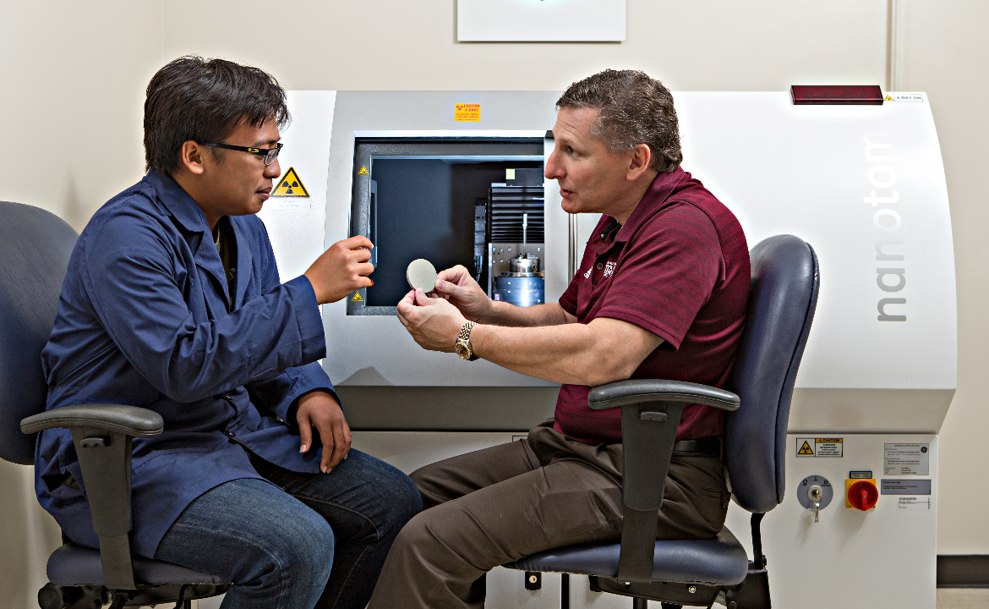
Proposal Preparation and Submission
The proposal administrators assist researchers with the preparation and submission of proposals to sponsors for external funding. Services include budget development; completion of most administrative sections of the proposal; ensuring that the proposal is compliant with A&M System policies, System member’s requirements, state and federal regulations, and the funding opportunity’s specific terms and conditions. The proposal administrator will enter proposal information into MAESTRO where it will route for review and approval to appropriate stakeholders. After review and approval, the proposal administrator submits the proposal to the sponsor and tracks receipt of the proposal.

Slide 7
Contract Negotiation
Agreements require careful review to protect the interest of the researcher and the system member. An SRS contract negotiator will review the terms and conditions of agreements for non-standard conditions and negotiate any necessary changes. To confirm agreements are acceptable, SRS contract negotiators also consult, as needed, the A&M System’s Office of General Counsel, Technology Commercialization, and the appropriate system member’s administration.

Slide 8
Project Administration
The project administration team establishes and monitors sponsored project accounts and provides a summary of award regulations and requirements for each account to the researcher and departmental administrators. The team also provides expenditure monitoring to ensure allowability and compliance with federal regulations, sponsor specific requirements, state and university system policies and procedures.

Slide 9
Accounts Receivable
Sponsored project invoicing, letter of credit draws, and financial reporting are conducted by our accounts receivable team in accordance to the sponsor’s terms. Collection of aged receivables are also managed by the SRS accounts receivable team.

Slide 10
Members Currently Served
Texas A&M System Office
Texas A&M University
Tarleton State University
Texas A&M AgriLife Research
Texas A&M AgriLife Extension Service
Texas A&M Veterinary Medical Diagnostic Laboratory
Texas A&M Engineering Experiment Station
Texas A&M Health Science Center
Texas A&M Corpus Christi
Texas A&M University Galveston
Texas A&M University Qatar

Slide 11
Metrics & Reporting FY2017
Pre-Award
Number of proposal submitted: FY16 4,986
Number of contracts negotiated: FY16 2,341
Awards (continued)
Number of actively managed projects: As of 07/31/17 5,019
Number of actions processed in FY16 7,048 (New 3,103; All other 3,945)

Slide 12
Metrics & Reporting FY2017
Accounts Receivable and Reporting
Number of financial reports submitted: FY16 2,098
Number of invoices sent: FY16 12,808
Number of letter of credit draws: FY16 2,011

Slide 13
Assessment Upon Arrival
Research Community Feedback
Reduce Staff Turnover
Need Better Trained Employees
SRS Contact Information
Awards/Modifications Established More Timely
Need for a New Comprehensive Electronic Research Administration (ERA) System
Proposal Administrators Were Not Receiving Proposals to Submit Timely
April 2016

Slide 14
Assessment Upon Arrival
What Was Discovered
High Rate of Staff Turnover ~30%
Employees Needed More Training and Better Tools – Manuals/Desk References
Proposal Administrators Were Not Receiving Proposals to Submit Timely
Awards/Modifications Needed to be Set-up More Timely/Need for Interim Funding
Some Duplication of Processes
Data Integrity Concerns
Lack of Transparency for Leadership and Members SRS Serves
Few Useful Metrics & Reports Available for Decision Making & Not Easy to Access
Need to Restructure Some Areas/Reallocation of Resources
April 2016

Slide 15
Process Mapping
To gain efficiencies and to identify any areas of weakness we conducted process mapping on the following areas:
Proposal Submission Contract Negotiation
Award Set-up Accounts Receivable
Subrecipient Monitoring Cash Management
Travel

Slide 16
Accomplishments To Date
From FY16 to FY17 Staff Turnover Has Been Reduced From ~27% to ~13%
(does not include internal moves or retirements)
Evaluated Staff Workloads to Provide Better Service and Retain Employees
Completed Process Mapping
Identified Duplicate or Unnecessary Processes and Realigned Duties
Reallocate Resources to Boost the Proposal Team
National Council of University Research Administrators (NCURA ) Training – targeted at early career research administrators
Proposal Submission Guidelines

Slide 17
Data Integrity
Award and Account Set-up and Expediting Team (AASET) performs the role of intake of award documents from sponsors, sets up interim funding (when appropriate), and establishes sponsored projects and accounts in MAESTRO and FAMIS. This includes issuing a summary of award regulations and requirements for each account to the researcher and departmental administrator. AASET is also responsible for managing the sponsor tables in MAESTRO and data integrity of the award set-up.
AASET is led by Katherine Kissmann, Director
Projects Will be Available Timely so Investigators can Start Work
Ensure Data Integrity at time of Award Establishment
Allows Project Administrators to Better Manage Projects and to be Proactive Rather Than Reactive.

Slide 18
Data Integrity
Introducing AASET Staff
Name | Role
Katherine Kissmann | Director
Joanie Birdwell | Award and Account Setup Administrator
Alice Conchola | Award and Account Setup Support
Greg Ganske | Award and Account Setup Administrator
Kelly Ganske | Award and Account Setup Administrator
Nancy Ginn | Award and Account Setup Administrator
Elizabeth Grizzaffi | Award and Account Setup Support
Debra Hodge | Award and Account Setup Support
Sara Poremski | Award and Account Setup Administrator
Ginger Pierce | Award and Account Setup Administrator
Pauline Recek | Award and Account Setup Support
AASET

Slide 19
Impact to the Research Community
Investment in Human Capital Which Reduced Employee Turnover
Better Customer Service
Transparency for Leadership and Members
Creating Metrics & Reports
New SRS Website
Single Point of Contact for Post-Award Administration
SRS Administrators Maintaining Office Hours within the Member
Outreach to Campus Research Community

Slide 20
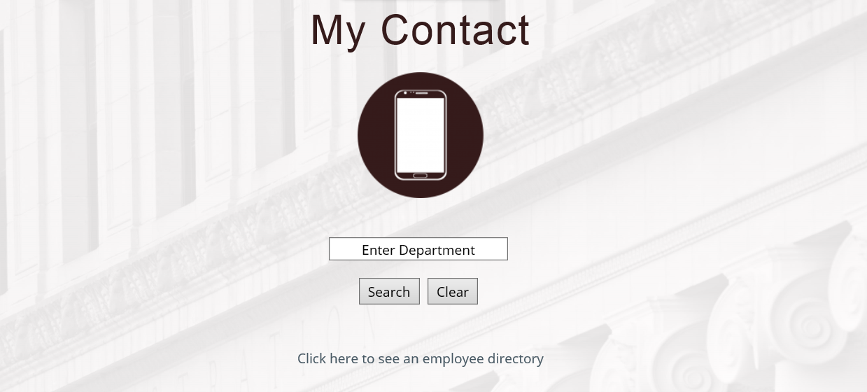
How Can We Help You
srs.tamu.edu

Slide 21
ERA System Search
Spring 2017 a Task Force Was Assigned to Explore the options for a New Pre-award Electronic Research Administration (eRA) System
Co-Chaired by Dr. Ulisses Braga Neto and Dr. Matt Sheldon
Viewed Three ERA Systems:
Click Open Lab May 26, 2017
Kuali Co. Open Lab July 28, 2017
Streamlyne Open Lab August 22, 2017
The timeline for standing up a new ERA system is two years at a minimum

Slide 22
ERA System
The electronic research administration (ERA) System is tasked with developing, implementing,
and maintaining the enterprise information system named MAESTRO. MAESTRO supports researchers and research administration across the A&M System. Through various models MAESTRO provides transparency to users so that they may review and approve their proposals prior to submission to the sponsor, check the status of contracts in negotiation, and view post-award information.
In the Interim Continue to Improve Existing ERA System: MAESTRO
Executive Portal
PI dashboard

Slide 23
Forums to provide input
Texas A&M Stakeholder Operations Committee (TSOC)
Council of Principal Investigators (CPI)
University Research Council (URC)
Faculty Senate
University Distinguished Professors

Slide 24
Executive Leadership
We are here to assist and facilitate so please contact us with any questions or concerns
Kristi Billinger, Executive Director
kristib@tamu.edu
979-845-8673
Associate Executive Directors
Lesley Bell Julie Bishop Crissy Stratta
lbell@tamu.edu jbishop@tamu.edu cstratta@tamu.edu
979.845.7864 979.458.8760 979.458.8452

Slide 25
Questions or Comments
srs.tamu.edu

